Slide 1

Lecture 8: TAU Advances
Allen D. Malony
Department of Computer and Information Science

Slide 2
Outline
General hybrid parallel profiling
Cross-platform OpenMP performance analysis
Empirical autotuning

Slide 3
General Hybrid Parallel Profiling
Two types of measurement approaches
Sampling-based measurement (SBM)
measure performance by statistical observation
a.k.a. statistical sampling or event-based sampling
Probe-based measurement (PBM)
measure performance by insertion of code into a program
Is it possible to combine approaches?
Idea is to investigate a hybrid approach
Integrate sampling-based and probe-based methodology
Improve performance observability
A. Morris, A. Malony, S. Shende, K. Huck, “Design and Implementation of a Hybrid Parallel Performance Measurement Systems,” International Conference on Parallel Processing (ICPP), San Diego, Septemer 2010.
A. Malony, K. Huck, “General Hybrid Parallel Profiling,” International Conference on Parallel, Distributed, and Network-based Processing (PDP), Turin, Italy, February 2014.

Slide 4
Approach Assumptions
SBM can measure/attribute performance accurately if:
Code segments are executed repeatedly
Execution is long enough to collect a large # of samples
Sampling frequency is uncorrelated with execution
SBM is grounded in statistical sampling theory
PBM can measure performance accurately if:
Overhead of executing the measurement code is sufﬁciently small relative to the size of the entity being measured
Intrusion due to measurement overhead in one thread does not affect the performance of any other threads
PBM is grounded in measurement theory

Slide 5
Hybrid Performance Measurement
Combine SBM and PBM techniques
Look for opportunities for synergies
Alternatives
1) Just use both at the same time, but independently
- works fine (as long as measurements tools are compatible) - lose benefit of integration between SBM and PBM data
2) Base combined system on SBM - Dynamic statistical sampling of PBM data - Example: mpiP (MPI communication), HPCToolkit, ...
3) Base combined systems on PBM - Augment PBM view with SBM data - Dynamic measures with event correlation from PBM

Slide 6
Hybrid Trace Measurement (TAUebs)
Inspired by Barcelona Supercomputing Center (BSC) work
Combines TAU, PerfSuite, and HPCToolkit
TAU for probe-based instrumentation and measurement
PerfSuite technology for timer-based sampling
HPCToolkit for call stack unwinding on fully-optimized codes
Foundation is TAU (PBM) with linked SBM capabilities
Synergy through "context" linking
Determination of dynamic offset from event start (BSC)
Tradeoff of degree of instrumentation versus SBM type
Utilize SBM to observe fine-grained performance
Use SBM to sample performance not easily obtained
Augment PBM with SBM performance views

Slide 7
The Notion of Context in TAUebs
SBM methods capture context on interrupts (traps)
Program counter (PC) and possibly PC call path
walk the call stack to see all active routines
Performance data and other state information
Together it gives the sample context (PC context)
PBM methods also have context
Current event and possibly a TAU event path
any instrumented event (routine or user-defined)
walk the event stack to see all active events (TAU event path)
Performance data and other state information
Together it forms the event context (TAU context)

Slide 8
Context Merging
Get more information if can merge contexts
At interrupt, SBM can “reach over” into PBM
Current TAU context contains event state
PC context can be qualified with TAU context
think about "sampling" TAU context and save with PC context
There may be overlap in PC call path and TAU event path
Offers opportunity to optimize retention of context information
Need to figure out how to resolve overlap
Alternative 1: store both
problems: handle C++ name mangling, non-routines not handled
Alternative 2: walk PC call stack to event at top of event stack
problem: need to make efficient at runtime

Slide 9
TAU Event Stack and PC Callstack
Call stack snippets
. . .
interrupt!
. . .
D
C
Loop2
Bar
Loop1
B
PCkey
TAUkey
Bar
Foo
Foo
A
Main
Main
TAU Event Stack
PC Call Stack
Loop1 and Loop2 are not routines!

Slide 10
TAUebs Measurement
What measurement is made with each sample?
Capture a trace of EBS samples
Each TAUebs sample contains:
Timestamp
TAUkey (key to current TAU event stack)
PCkey (key to current PC call stack)
Hardware counters
Delta (optional)
subtract start time of top TAU event from timestamp
support BSC code folding analysis

Slide 11
TAUebs Data Analysis (Trace)
EBS to OTF trace converter
Analyze EBS trace with trace analysis tools
For each sample
Place timestamp in trace record
Merge TAU event stack and PC call stack
merged call path
Create event ID for merged call path
put in trace record
Put collected PAPI metrics in trace record
Can store PC locations in trace record as well

Slide 12
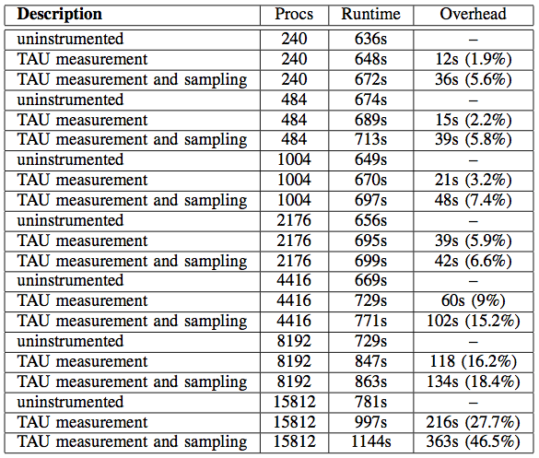
TAUebs FLASH Experiments on IBM BG/P
FLASH is a nuclear astrophysics simulation
Compare measurement overhead
TAU only
Hybrid
Adding EBS tracing leads to high overhead at high core counts

Slide 13
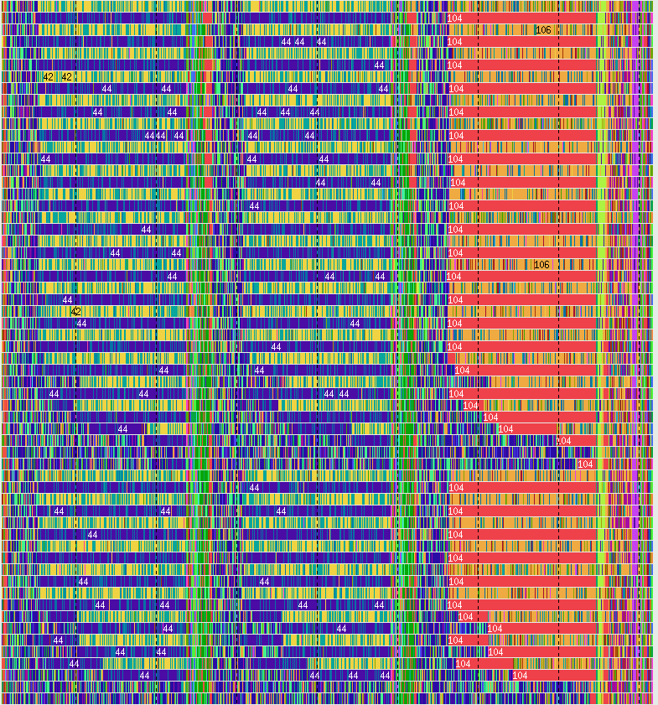
TAUebs Trace for FLASH (240 processes)
Color-coded by filename
Alternating patterns due to dual mode
40 secs

Slide 14
Hybrid Profiling
Hybrid tracing with TAUebs is not scalable
Need to have a parallel profiling methodology
However, hybrid profiling is more challenging
Online analysis to is more complex
Can leverage the hybrid ideas in TAUebs
Associate samples with the active probe context
Goal is to capture all of the performance information possible at runtime to produce equivalent profile results from trace-based analysis

Slide 15
Approach
TAU profiling
EBS at 100ms
Per thread
Determine PC
Unwind callstack
Use Linux backtrace facility
Sample mapping
Determine event context (TAU context)
Update hybrid profile for every unique tuple: {event context, PC, call path}
Done for every thread of execution

Slide 16
Hybrid Profile Generation
At the end of application’s execution
Sample addresses are resolved to symbolic names
use GNU binutils (if fail, display as “UNRESOLVED”)
Profile metric statistics are calculated
Hybrid profiles are written to files
For each probed event context for each thread
Profile entry created to represent samples in the context
each unique sample represented as “SAMPLE” event
“SUMMARY” entry aggregates across samples
“context events” share the name of probed parent
labeled as “CONTEXT” in the profile
“UNWIND” event nodes are call sites that eventually end with a sample event

Slide 17
A Simple Hybrid Profiling Example
Sequential matrix multiplication
3 matrix sizes: 128x128, 256x256, 512x512
Use small routines that are hard to probe
Insert probes to record phases and parameters
PHASE_START PHASE_STOP
PARAM_PROFILE_START PARAM_PROFILE_STOP
Compare sampling-only, probe-only, and hybrid
Machine: Intel Xeon X5650, 2.67 GHz, 72 GB

Slide 18
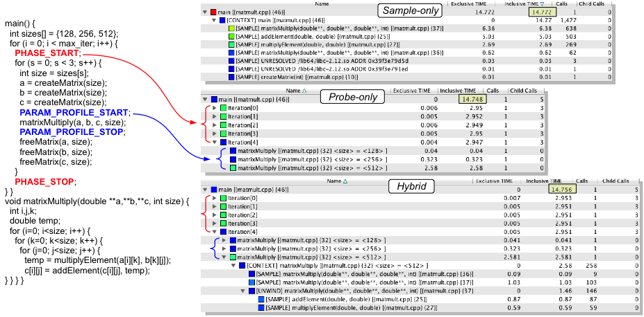
Sequential Matrix Multiplication

Slide 19
Benefits of Hybrid Profiling
PBM can not be used observe small events
Overhead of measurement affects accuracy
High-frequency probes also accumulate overhead and can intrude on code behavior
Disabling events is necessary
Hybrid profiling uses sampling to see lightweight code execution performance
Probe context allows richer sample projection performance on program regions and semantics
TAU’s unique event naming allows semantics to be extended to hybrid profiling data

Slide 20
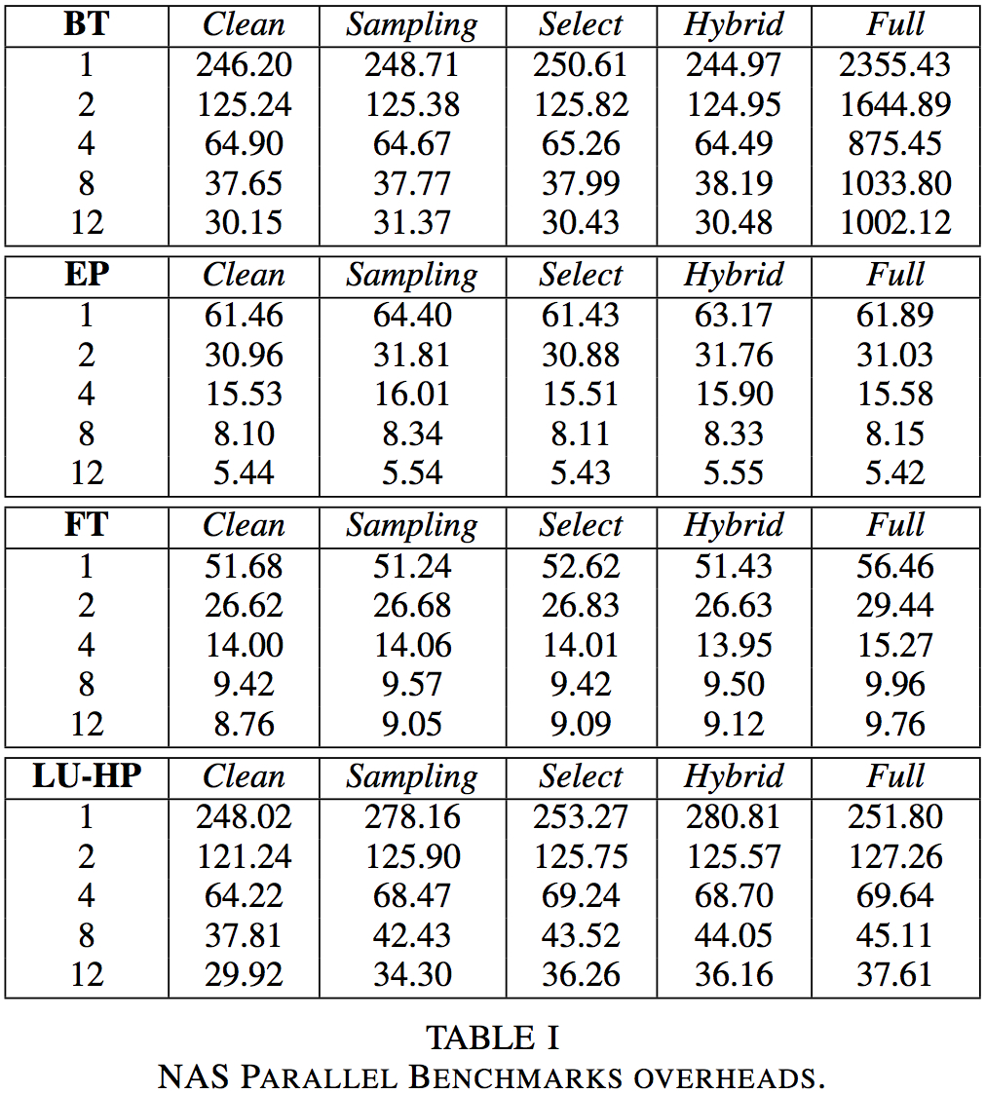
Evaluation of Hybrid Profiling Overhead
Test on OpenMP version of NAS parallel benchmarks
Characterize overhead against uninstrumented runs (Clean):
Full / Select (probe)
Sampling
Hybrid
Interested in relative overhead of hybrid

Slide 21
NPB BT Experiments
Naïve full instrumentation has high overhead
Want to see hybrid data with respect to X,Y,Z phases
phases

Slide 22

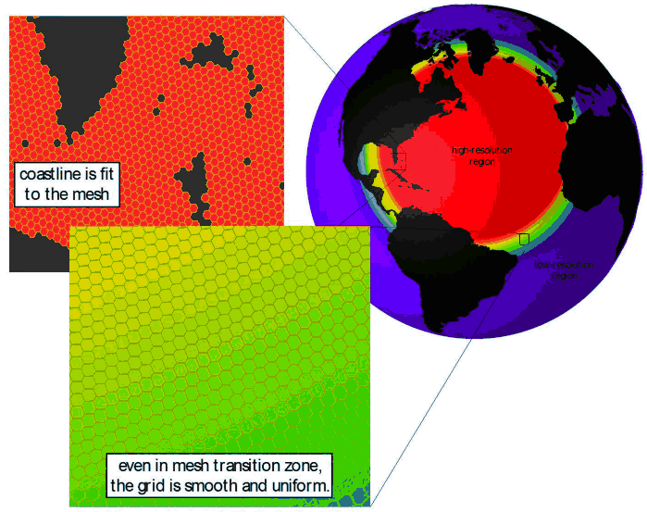
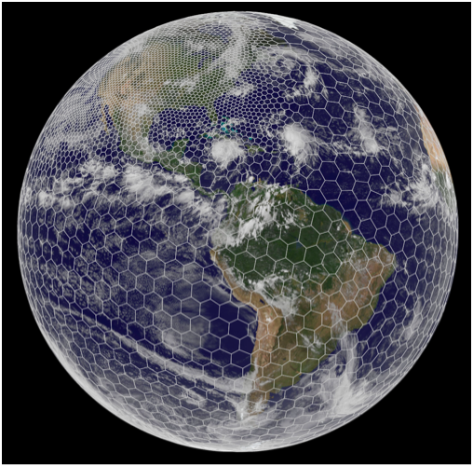
MPAS-Ocean Engagement
Use multiscale methods for accurate, efficient, and scale-aware models of the earth system
MPAS-O uses a variable resolution irregular mesh of hexagonal grid cells
Cells assigned to MPI processes as “blocks”
Each cell has 1-40 vertical layers, depending on ocean depth
MPAS-O has demonstrated scaling limits when using MPI alone
Look at increasing concurrency
OpenMP
Vectorization
Use hybrid profiling to better understand performance behavior
Experiments performed on Hopper
Cray XE6

Slide 23
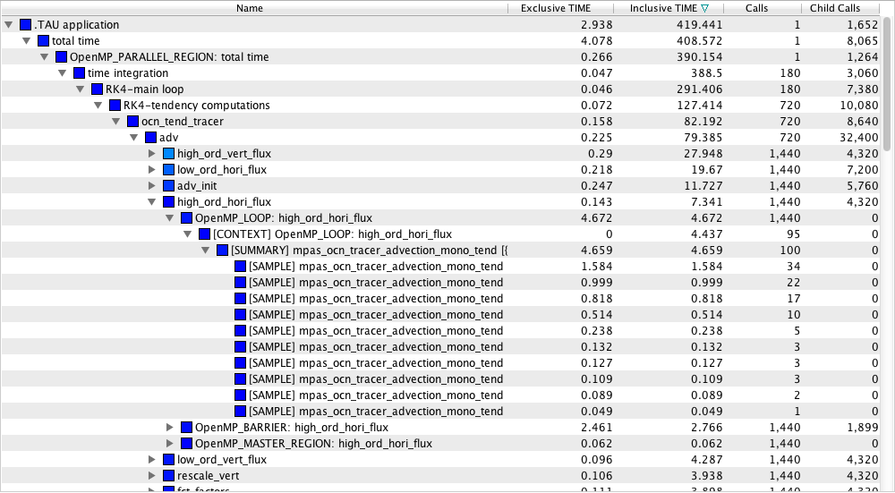
MPAS Hybrid Profile
OpenMP probes
Samples

Slide 24
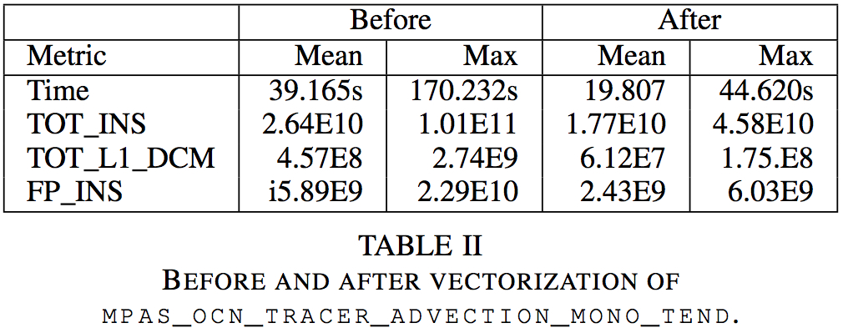
Hybrid Profiling to Measure Vectorization
Solver vectorization gave ~20s reduction (mean)
Worst case solver performance went from 170s to 44s
Subsequent ~52s reduction in MPI_Wait time! Why?

Slide 25
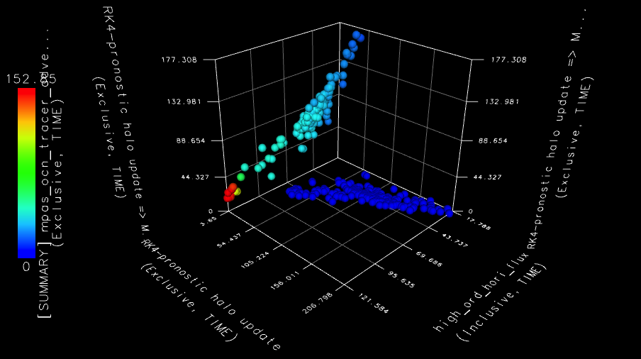
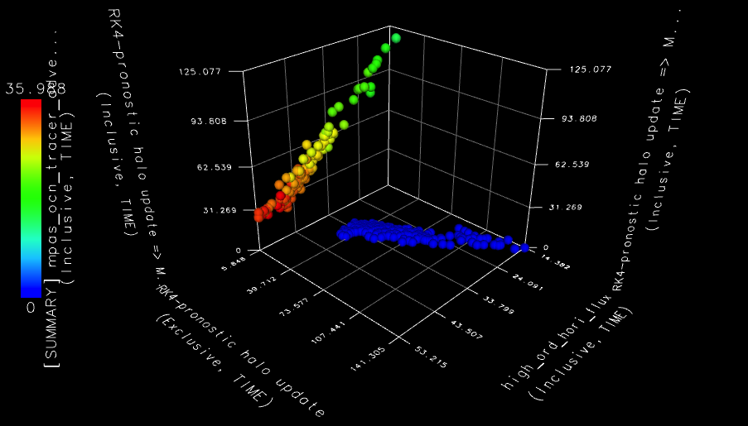
Vectorization Analysis with Hybrid Data
Computation and synchronization are correlated
Load imbalances seen in larger MPI wait (unvectorized)
Vectorization tightens the imbalances
Depth + color show vectorization effect (faster, more uniform)
Smaller communication waiting (height and width)
non-vectorized
vectorized

Slide 26
Next Steps in Hybrid Parallel Profiling
Hybrid parallel profiling provides the user with various options to control measurement
Probing: select events, enable event paths and depth
Sampling: interrupt period, call stack unwinding depth
Capture of timing information and hardware counters
These are also dynamic hybrid controls
Unwinding of call stack to last probed event
reduces time spent unwinding
Need to determine an event’s parent quickly
Useful for event contextualization and callsite profiling
Hybrid techniques can be used to implement “folding”
Collect samples with counters for a region to create a statistical model of performance

Slide 27
Cross-Platform OpenMP Performance Analysis
Parallel language performance observability requires both visibility of performance data and the semantic context in which the performance occurs
Portable OpenMP performance observability is problematic because of lack of a standard
Language semantics hide low-level parallel operation
Compilers hide complexity of runtime implementation
Different OpenMP compilers do things differently
How can portable OpenMP performance measurement and analysis be provided?

Slide 28
OpenMP Performance API Efforts
There has always been a strong interest in the OpenMP community about performance observability
Several efforts have been investigated previously
POMP interface (Research Centre Juelich, U. Oregon)
OpenMP Runtime API (ORA) (a.k.a. Collector API) (Sun)
Neither approach caught on as a standard
OpenMP Tools Working Group
Focusing on defining an OpenMP API for tools (OMPT)
Other interesting developments
GCC OpenMP runtime library (GOMP)
Intel OpenMP runtime system is now open source

Slide 29
Approach
Even if have an OpenMP performance interface, still need to develop tools to use it
Consider the present compiler landscape
Implement support in TAU for different methods
Leverage TAU’s portable measurement and analysis
Utilize portable OpenMP measurement for cross-compiler and cross-platform OpenMP performance analysis

Slide 30
POMP / Opari
Source code instrumentation approach
POMP / POMP2 defines events that expose OpenMP operational semantics at the source level
Provides an interface for a measurement system
C/C++ and Fortran
OpenMP Pragma and Region Instrumentation (Opari)
Source-to-source transformation utility
Passes semantic information through region descriptors
Tools supporting POMP and Opari
TAU, Kojak, Scalasca
POMP / Opari can only observe source-level events
Constrained from seeing anything about runtime
Has no insight on uninstrumented OpenMP libraries

Slide 31
POMP / Opari Example
#pragma omp parallel for for (i=nStart; i<=nEnd; ++i) { foo(); }
int pomp2_num_threads = omp_get_max_threads(); int pomp2_if = 1; POMP2_Task_handle pomp2_old_task; POMP2_Parallel_fork(&pomp2_region_1, pomp2_if, pomp2_num_threads, &pomp2_old_task, pomp2_ctc_1); #pragma omp parallel POMP2_DLIST_00 firstprivate(pomp2_old_task) if (pomp2_if) num_threads(pomp2_num_threads) { POMP2_Parallel_begin(&pomp2_region_1 ); { POMP2_For_enter(&pomp2_region_1, pomp2_ctc_1); #pragma omp for nowait for (i=nStart; i<=nEnd; ++i) { foo(); } { POMP2_Task_handle pomp2_old_task; POMP2_Implicit_barrier_enter(&pomp2_region_1, &pomp2_old_task ); #pragma omp barrier POMP2_Implicit_barrier_exit( &pomp2_region_1, pomp2_old_task ); POMP2_For_exit( &pomp2_region_1 ); } POMP2_Parallel_end( &pomp2_region_1 ); } POMP2_Parallel_join( &pomp2_region_1,pomp2_old_task );
}

Slide 32
OpenMP Runtime API (ORA, Collector API)
First attempt at a standard OpenMP tools API
External API consists of a single function __omp_collector_api(void *)
Allows a tool to interact with the runtime system
Manages the collector
initialize, pause, resume, terminate
Registers a callback function for predefined events (22)
Query an existing thread’s state (11 states)
OpenMP ARB sanctioned the Collector API
Only supported in OpenUH and Solaris Studio compilers
Full support available in TAU with OpenUH and GOMP

Slide 33
Wrapping GCC OpenMP Runtime (GOMP)
GCC OpenMP runtime is libgomp (GOMP)
60 API calls to use to implement an OpenMP runtime
Use by GCC and other compilers
Use by source transformation tools (e.g., ROSE)
Apply TAU’s library wrapping technology to instrument for OpenMP performance measurement
tau_gen_wrapper wraps external libraries
Generates proxy functions implementing ORA
TAU now supports OpenMP for GNU compilers!
Fully portable across all systems supporting GCC
Wrapping still has limitations though
None of the GOMP internals are visible for measurement

Slide 34
Wrapping GCC OpenMP Runtime (GOMP)
typedef void (*GOMP_barrier_p) (); void tau_GOMP_barrier(GOMP_barrier_p real_GOMP_barrier { OMP_COLLECTOR_API_THR_STATE previous; previous = set_state(THR_EBAR_STATE); event_callback(OMP_EVENT_THR_BEGIN_EBAR); (*real_GOMP_barrier)();
event_callback(OMP_EVENT_THR_END_EBAR); set_state(previous);
}

Slide 35
OMPT
New standard effort that is likely to be adopted
Complete draft specification (see OpenMP Forum)
Design objectives
Low-overhead observation (application, runtime
Supports events and states (superset of ORA)
Stack frame for sampling
Blame shifting logic to resource synchronization
IBM has support in experimental XL compilers
Intel open sourced their OpenMP runtime and OMPT draft committed implemented for Intel compilers
TAU used as backend measurement system

Slide 36
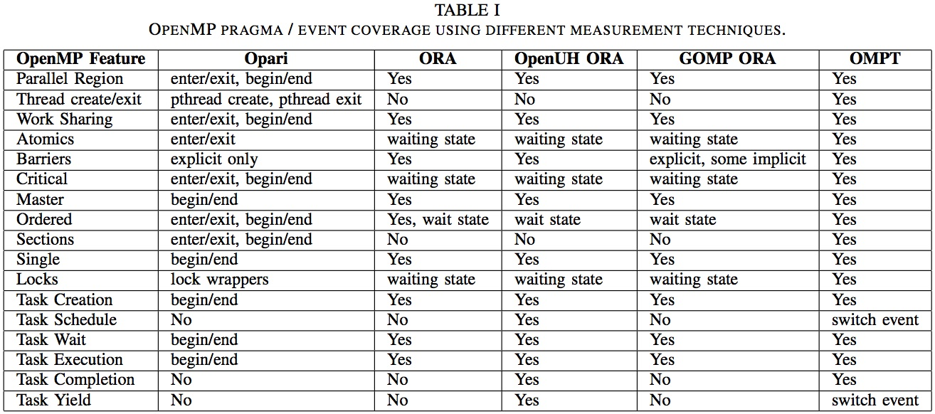
Comparison of Measurement Support

Slide 37
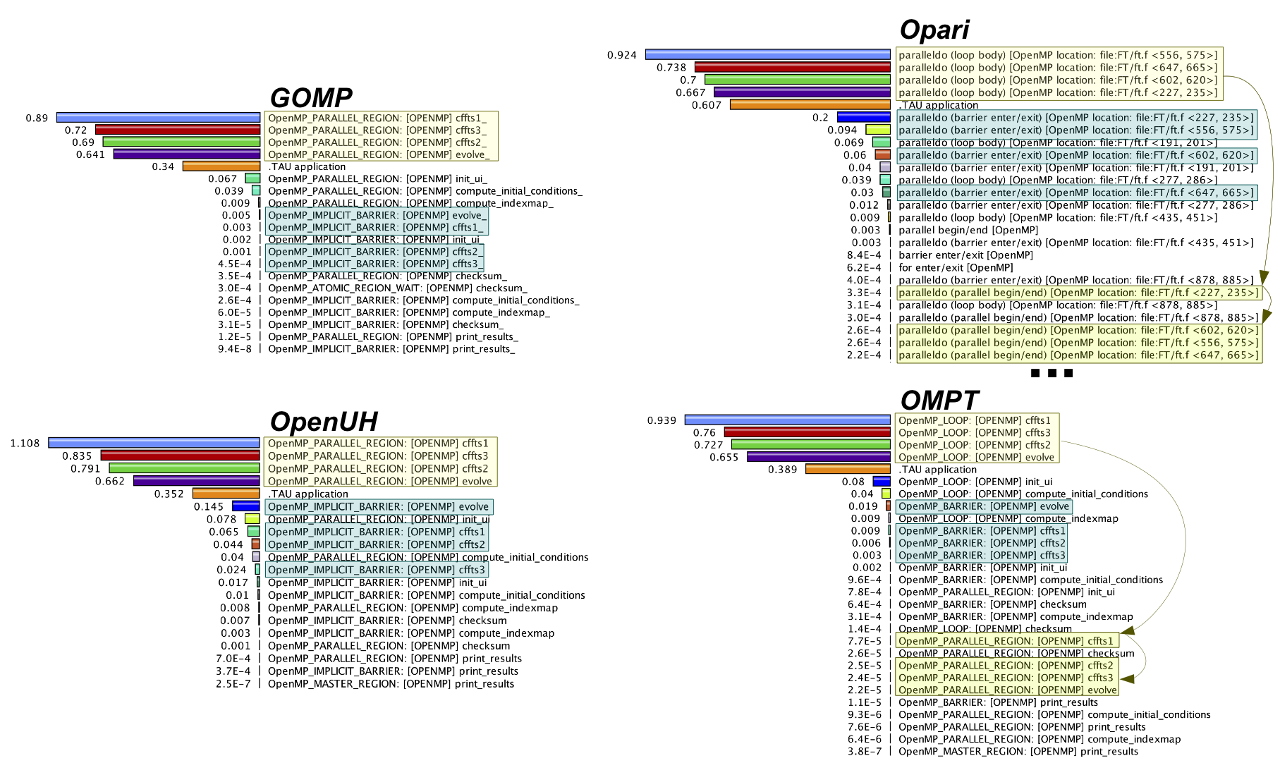
Flat Profiles for NPB FT.B Benchmark

Slide 38
Evaluation Experiments
Objective
Evaluate performance coverage
Not intended to compare differences between OpenMP compilers or runtime systems
Show that cross-compiler and cross-platform OpenMP performance measurement is possible
Benchmarks
NAS Parallel SPEC 2012 OpenMP Benchmarks
Barcelona OpenMP Task Suite (BOTS)
Compilers
GNU GCC versions 4.4.7-4.8.0
OpenUH 3.0.26 (with Collector API task extensions)
Intel 13.1.2
Default runtime settings
Platform
4x Intel X7560, 2.27 GHz, 8-core CPUs, 384 GB memory
All experiments done with OMP_NUM_THREADS = 32

Slide 39
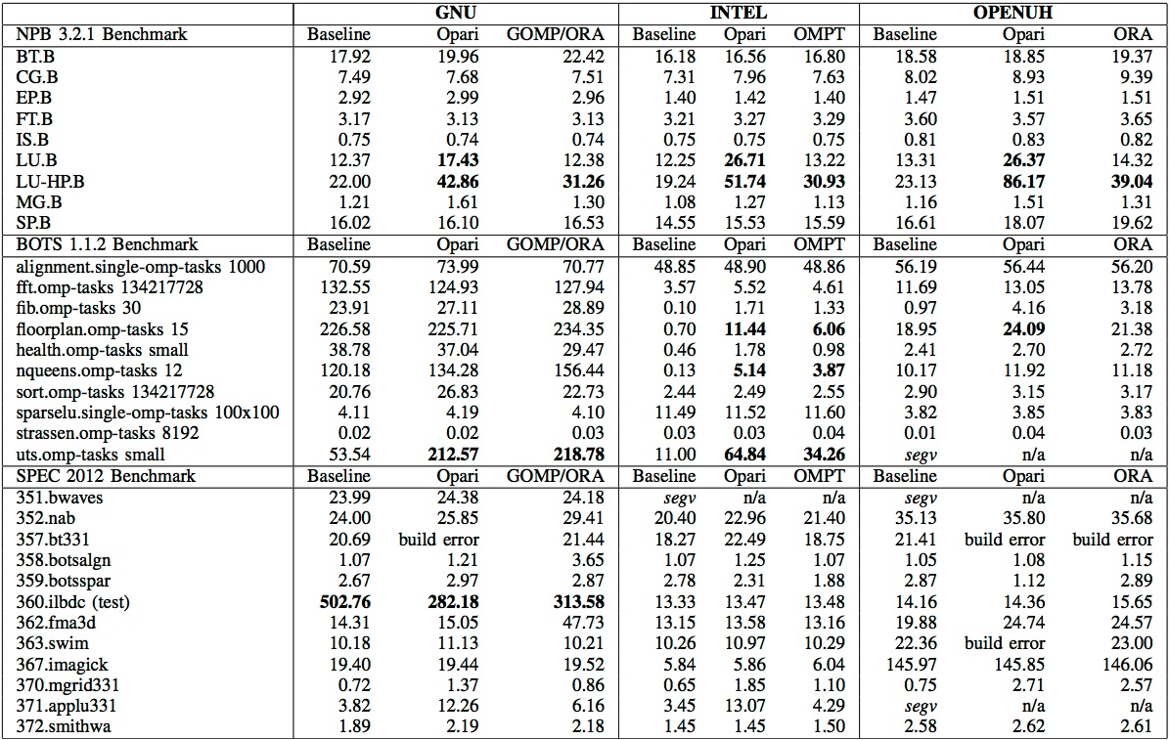
Overhead Measurements for 32 Threads

Slide 40
Mean Exclusive (floorplan.omp_tasks(15))
GOMP/ORA
OpenUH/ORA
Intel/OMPT
OpenUH/ORA with sampling

Slide 41
MPAS-Ocean Case Study
Demonstrate portable measurement of OpenMP application across compilers and platforms
Utilize different features to investigate performance characteristics
Scaling study with respect to design parameters
Decomposition
Solver implementation
OpenMP runtime scheduler
Platform
Hopper, Cray XE6

Slide 42
MPAS-Ocean Results

Slide 43
Next Steps for OpenMP Performance Tools
Important to provide portable OpenMP performance tools through integrated measurement
OMPT is likely to become an adopted standard
Work with OpenMP Tools Working Group
Implement OMPT specification with TAU as the measurement framework
Explore other OpenMP instrumentation avenues
Binary instrumentation can be important
Working with Dyninst and MAQAO
Cross-platform application performance evaluation
MPAS-O port to IBM BG/Q will require OMPT support
GOMP can be used on MPAS-O port to Cray Titan

Slide 44
Autotuning is a Performance Engineering Process
Autotuning methodology incorporates aspects common to “traditional” application performance engineering
Empirical performance observation
Experiment-oriented
Autotuning embodies progressive engineering techniques
Automated experimentation and performance testing
Guided optimization by (intelligent) search space exploration
Model-based (domain-specific) computational semantics
However, autotuning is based on optimization and search, not performance diagnosis
There are shared objectives for performance technology and opportunities for tool integration

Slide 45

TAU Integration with Empirical Autotuning
Autotuning components (DOE SUPER project)
Active Harmony autotuning system (Hollingsworth, UMD)
software architecture for optimization and adaptation
CHiLL compiler framework (Hall, Utah)
CPU and GPU code transformations for optimization
Orio annotation-based autotuning (Norris, University of Oregon)
code transformation (C, Fortran, CUDA) with optimization
Goal to integrate TAU with existing autotuning frameworks
Use TAU to gather performance data for autotuning/specialization
Store performance data with metadata for each experiment variant and store in performance database (TAUdb)
Use TAU Python analysis scripts, data mining, and machine learning to increase automation of autotuning and specialization

Slide 46
CHiLL: Compiler-based Autotuning
CHiLL is a compiler framework for loop transformations based on the polyhedral model
Used to automatically generate specialized versions according to specified optimization strategies
CHiLL provides a high-level scripting interface
Allows a user or a compiler to specify a sequence of code transformations and parameters
Describes the search space of specialized implementations
Heuristics trim the search space
Variants are generated, measured, and analyzed

Slide 47
CHiLL Transformation Scripts and Parameters
Transformation scripts are parameterized
Consider matrix multiply
TJ, TI, TK determine tile sizes
UI, UJ determine unroll factors
Overall search space is {parameters} x {scripts}
Each describes a transformation that produces a code variant

Slide 48
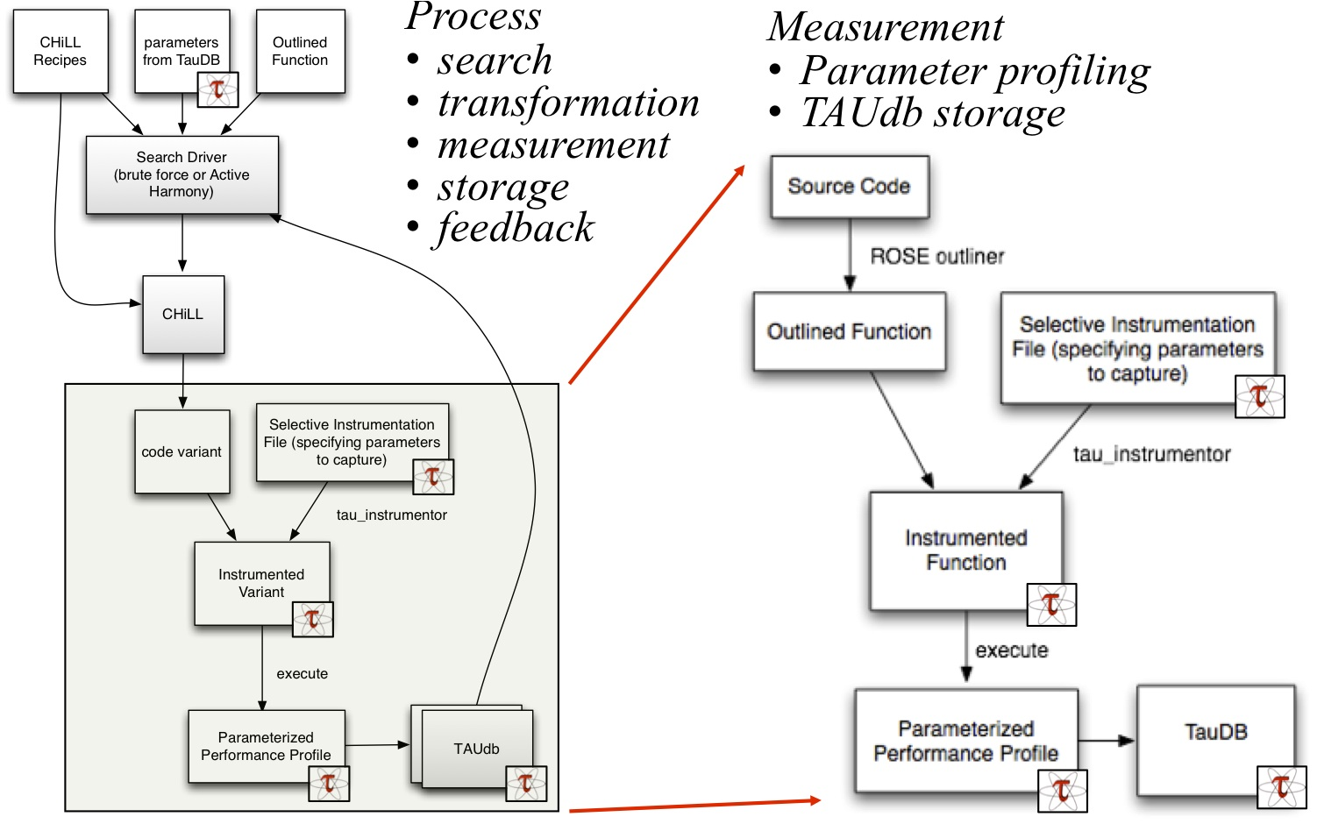
CHiLL + Active Harmony + TAU

Slide 49
Autotuning with TAUdb Methodology
Each time the program executes a code variant, we store metadata in the performance database indicating by what process the variant was produced:
Source function
Name of CHiLL recipe
Parameters to CHiLL recipe
The database also contains metadata on what parameters were called and also on the execution environment:
OS name, version, release, native architecture
CPU vendor, ID, clock speed, cache sizes, # cores
Memory size
Any metadata specified by the end user

Slide 50
Specialization using Decision Tree Learning
Apply machine learning to data stored in TAUdb
Generate decision trees based upon code features
Consider matrix multiply kernel
Matrices of different sizes with different performance
Automatically generate function to select specialized variants

Slide 51
Decision Code Generation for Specialization
Use a ROSE-based tool to generate a wrapper function
Carries out the decisions in the decision tree and executes the best code variant
Decision tree code generation tool takes Weka-generated decision tree and a set of decision functions
If using custom metadata, user needs to provide a custom decision function
Provide decision functions for metadata to be automatically collected by TAU

Slide 52

Orio: DSL-based Transformation for Autotuning
Express any properties of the computation that can possibly be exploited to optimize performance
Ones that a general purpose language (GPL) compiler cannot determine necessarily
dense representation of the sparse matrix from stencil
Approach
Define new DSLs or embeddable restricted GPLs
Augmentable with optimization specifications
capture typical optimizations (e.g., tiling, unrolling, …)
specialized implementations (e.g., different input sizes)
Transform code based on knowledge in various forms
Evaluate performance of variants (different code output)
Search for best

Slide 53
Orio Autotuning Framework
OpenCL

Slide 54
Orio and TAU Integration
Source code annotations (pragmas) allow Orio to generate a set of low-level performance optimizations
Focus on code for accelerator cards
Run kernel after each optimization (transformation) applied
Set of optimizations is searched to find the best for a kernel
Integrated TAU with Orio to collect performance data about each experiment that Orio runs
Performance data collected by TAU are stored in TAUdb and are fed back to Orio
Allows Orio to tune based on any TAU metric
Performance data in TAUdb can be analyzed by TAU data mining routines

Slide 55
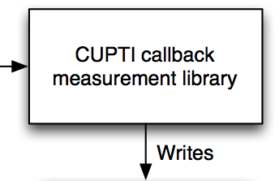

Orio and TAU Integration
OpenCL
OrCUDA
CUDA
Measurement
Metric profiling
Metadata
TAUdb storage
Autotuning analysis
Machine learning
Optimization search
specialization

Slide 56
Orio Transformations
Orio already supports transformation to for CUDA kernels
Search of a parameter space on thread count, block count, cache blocking, L1 size, loop unrolling
Use TAU’s support for CUPTI to gather CUDA performance
Recently we added support for OpenCL code generation
Analogous to the existing CUDA support
Allows generation of OpenCL kernels from the same original code as for CUDA
Allows different platforms to be targeted (CPUs, GPUs, Phi)
Use TAU’s OpenCL library wrapper to gather performance
TAU allows us to use the same measurement infrastructure to gather performance data for all these experiments
Metadata describing the applied transformations and the execution environment (accelerator type, memory sizes, …) are stored with the profiles in TAUdb

Slide 57
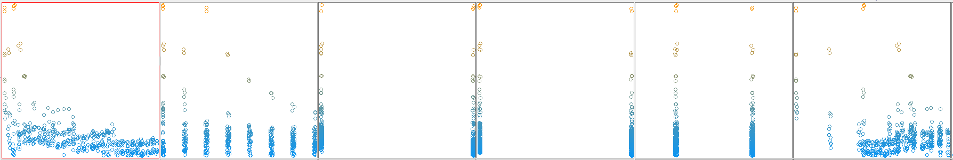
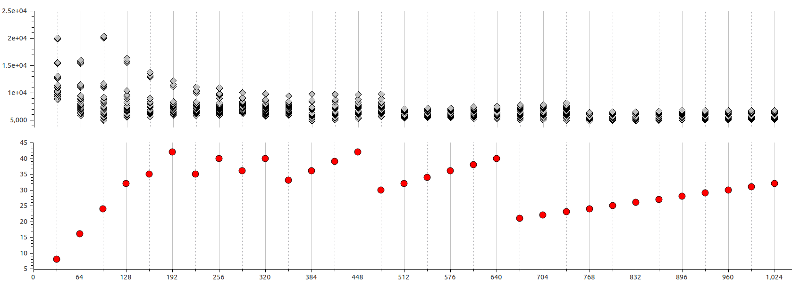
Orio Tuning of Vector Multiplication
Orio tuning of a simple 3D vector multiplication
2,048 experiments fed into TAUdb
TAU PerfExplorer used Weka for component analysis
Threads Per Block
# of Blocks
Unroll factor
Preferred L1 Size
CFLAG
Warps Per SM
Kernel Execution Time
Kernel Execution
Time (us)
GPU occupancy
(warps)

Slide 58
Initial Configuration Selection
Speed autotuning search process by learning classifier to select an initial configuration.
When starting out autotuning a new code:
Use default initial configuration
Capture performance data into TAUdb
Once sufficient data is collected:
Generate classifier
On subsequent autotuning runs:
Use classifier to propose an initial configuration for search
Could also implement a guided search
With the Active Harmony plugin interface, we could provide input beyond the first step of the search

Slide 59
Initial Configuration Selection Example
Matrix multiplication kernel in C
CUDA code generated using CUDA-CHiLL
Tuned on several different NVIDIA GPUs
S1070, C2050, C2070, GTX480
Learn on data from three GPUs, test on remaining one
Results in reduction in evaluations required to converge.

Slide 60
Multi-target Autotuning
Extend Orio with support for OpenCL autotuning code generator (OrCL transformation module)
Enable autotuning across a broader set of architectures
CPU
GPU (NVIDIA, AMD)
Xeon Phi
Allows for comparison of different generated code
CUDA versus OpenCL
More portable (not necessarily performance portable)
Leverage more TAU integration to utilize hardware counter data in the optimization process

Slide 61
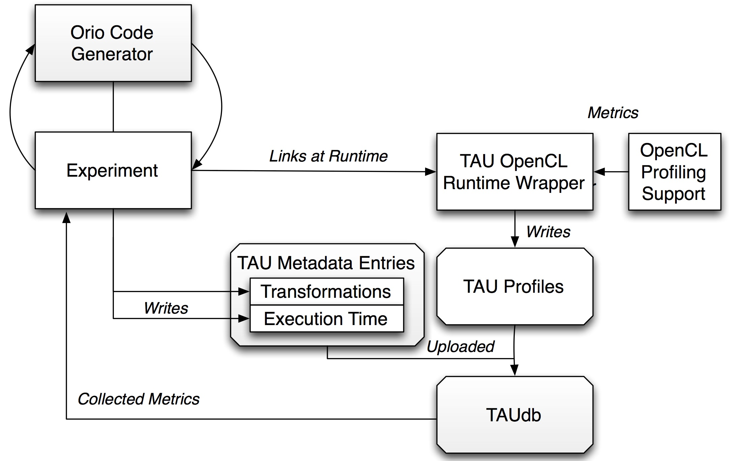
TAU Integration in Orio for OpenCL
OrCL

Slide 62
Orio OpenCL Tuning Specifications
Sections
performance_params describing the parameter values which make up the search space for autotuning
build describes how generated variants can be compiled
input_params describes properties of the inputs against which generated variants are tested
input_vars section specifies the values of the inputs
performance_counter, performance_test_code describe how performance measurements of the generated variants are to be made

Slide 63
Orio OpenCL Transformation Statement
Makes use of the parameter values described in the tuning specification
workGroups – # of OpenCL work groups to use
workGroups * workItemsPerGroup gives the overall number of threads that make up a kernel invocation, the global work size
workItemsPerGroup – # of work items (threads) that make up each work group
controls the local work size
each device has a maximum number of work items per group, which can be queried on the host
sizeHint – OpenCL provides a pair of function attributes which provide hints to the compiler about the expected local work size (work_group_size_hint, reqd_work_group_size)

Slide 64
Orio OpenCL Transformation Statement
Other parameters:
vecHint
cacheBlocks
unrollInner
clFlags
device
Platform
OrCL is able to utilize all of these parameters in the code transformation decision analysis

Slide 65
Experimental Evaluation
Series of autotuning experiments on 6 devices
2 AMD GPUs,
3 NVIDIA GPUs
Intel Xeon Phi
Verify OpenCL code generator on BLAS kernels previously used with the OrCUDA code generator
Autotuned a subset of kernels that typically consume a significant portion of the solution time of Newton-Krylov nonlinear solvers
Also autotuned the function and Jacobian computations of a PETSc-based application solving a 3-D solid fuel ignition (SFI) problem
Relies on the vectors kernels

Slide 66
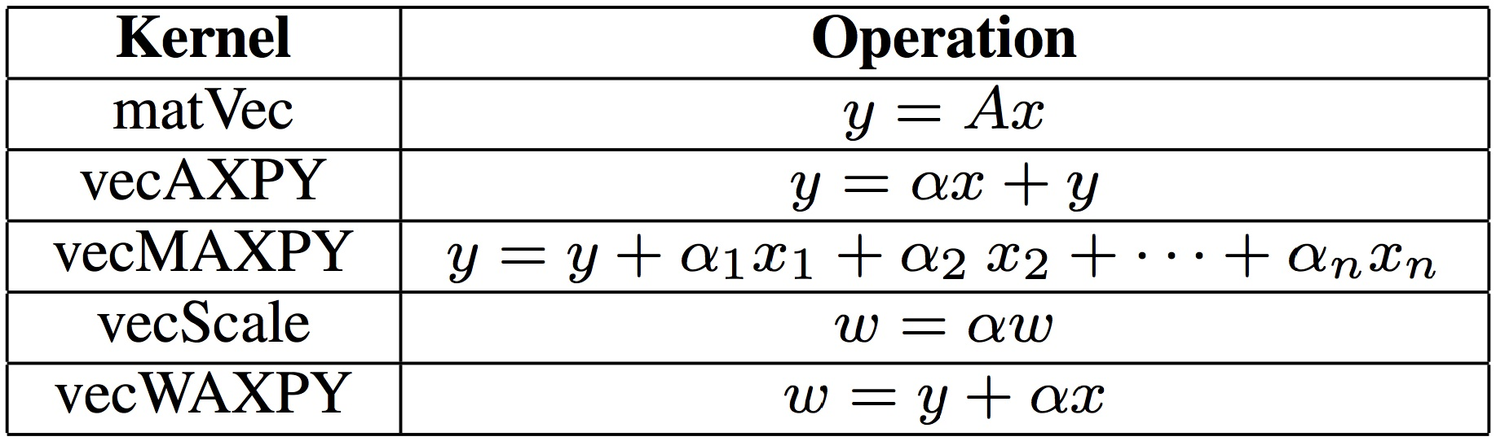
Vector Kernel Specifications

Slide 67
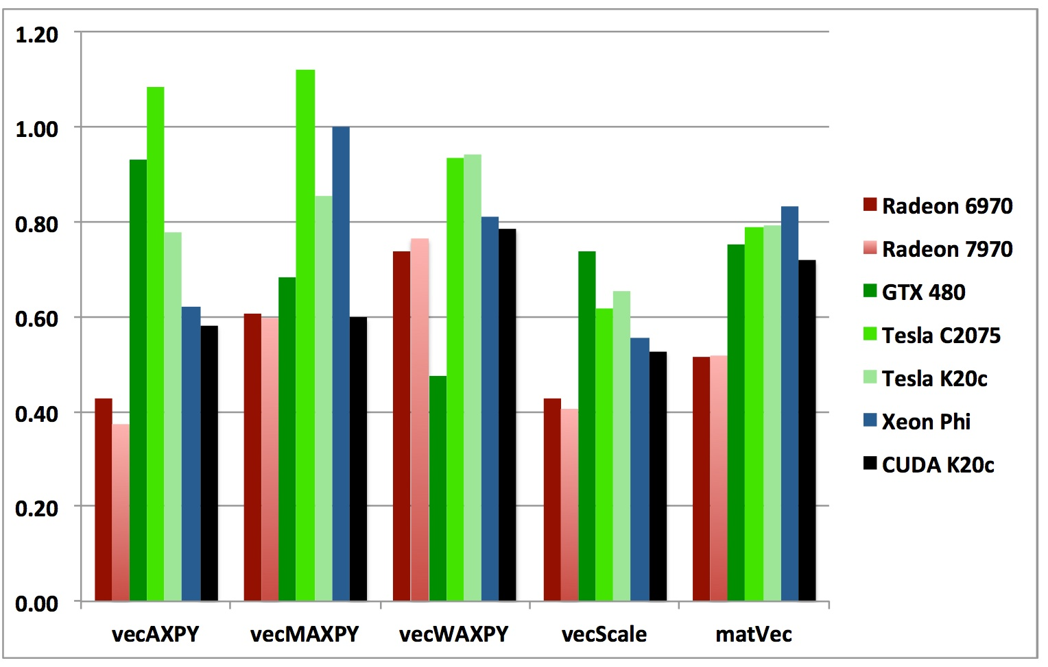
Kernel Performance
Normalized by ViennaCL times

Slide 68
Tuning Platforms and Autotuned Parameters

Slide 69
Autotuned Performance of Evaluated Variants
FormFunction (FF)

Slide 70
Autotuned Performance of Evaluated Variants
FormJacobian (FJ)

Slide 71
Autotuning Factors

Slide 72
Autotuning Autotuning
Apply the autotuning methodology to autotuning to improve the search process.
Use different search algorithms (or search parameters) and capture performance data and metadata as above
Also capture static code properties
Learn a classifier to predict which search algorithm to use, using as features
Properties of code
Properties of input data
Properties of execution environment

